Slide 1
Software Engineering Concepts
Lecture 3-4
Agile software development
usman.anwar@cuiatk.edu.pk

Slide 2
What is “Agility”?
Effective (rapid and adaptive) response to change
Effective communication among all stakeholders
Drawing the customer onto the team
Organizing a team so that it is in control of the work performed
Yielding …
Rapid, incremental delivery of software

Slide 3
Plan-driven and agile development
Plan-driven development
  A plan-driven approach to software engineering is based around separate development stages with the outputs to be produced at each of these stages planned in advance
Agile development
  Specification, design, implementation and testing are inter-leaved and the outputs from the development process are decided through a process of negotiation during the software development process

Slide 4
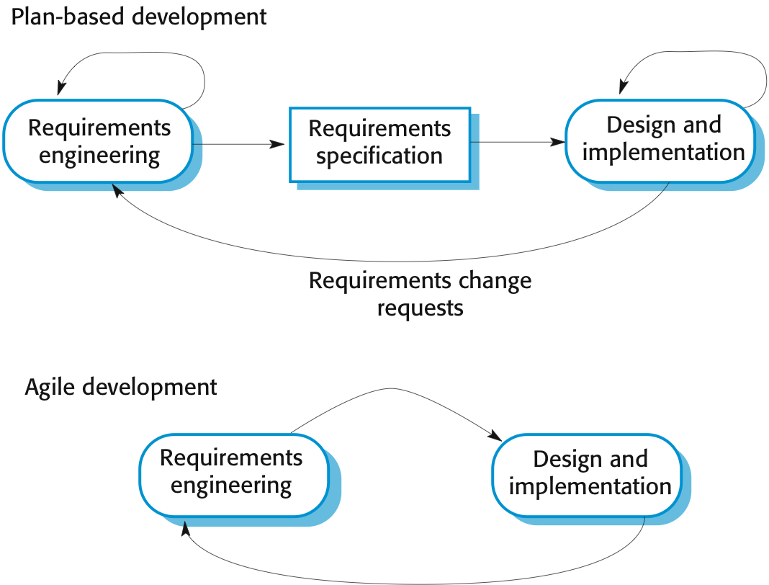
Plan-driven and agile specification

Slide 5
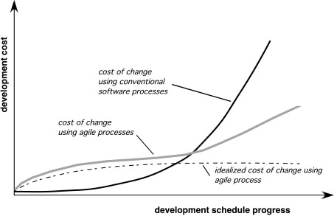
Agility and the Cost of Change
The cost of change increases nonlinearly as the project progresses

Slide 6
Agile Manifesto
“We are uncovering better ways of developing software by doing it and helping others do it. Through this work we have come to value:
  Individuals and interactions over processes and tools;
  Working software over comprehensive documentation;
  Customer collaboration over contract negotiation;
  Responding to change over following a plan;

Slide 7
The principles of agile methods
Principle | Description
Customer involvement | Customers should be involved throughout the development process. Their role is provide and prioritize new system requirements and to evaluate the iterations of the system.
Incremental delivery | The software is developed in increments with the customer specifying the requirements to be included in each increment.
People not process | The skills of the development team should be recognized and exploited. Team members should be left to develop their own ways of working without prescriptive processes.
Embrace change | Expect the system requirements to change and so design the system to accommodate these changes.
Maintain simplicity | Focus on simplicity in both the software being developed and in the development process. Wherever possible, actively work to eliminate complexity from the system.

Slide 8
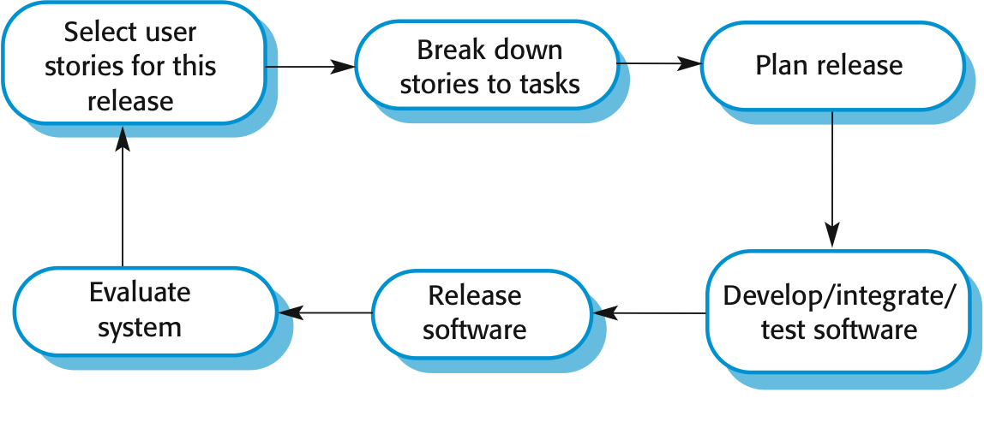
Extreme programming
Perhaps the best-known and most widely used agile method.
Extreme Programming (XP) takes an “extreme” approach to iterative development
  New versions may be built several times per day;
  Increments are delivered to customers every 2 weeks;
  All tests must be run for every build and the build is only accepted if tests run successfully
The extreme programming release cycle

Slide 9
Extreme programming practices (a)
Principle or practice | Description
Incremental planning | Requirements are recorded on story cards and the stories to be included in a release are determined by the time available and their relative priority.
Small releases | The minimal useful set of functionality that provides business value is developed first. Releases of the system are frequent and incrementally add functionality to the first release.
Simple design | Enough design is carried out to meet the current requirements and no more.
Test-first development | An automated unit test framework is used to write tests for a new piece of functionality before that functionality itself is implemented.
Refactoring | All developers are expected to refactor the code continuously as soon as possible code improvements are found. This keeps the code simple and maintainable.

Slide 10
Extreme programming practices (b)
Pair programming | Developers work in pairs, checking each other’s work and providing the support to always do a good job.
Continuous integration | As soon as the work on a task is complete, it is integrated into the whole system. After any such integration, all the unit tests in the system must pass.
On-site customer | A representative of the end-user of the system (the customer) should be available full time for the use of the XP team. In an extreme programming process, the customer is a member of the development team and is responsible for bringing system requirements to the team for implementation.

Slide 11
Testing in XP
Testing is central to XP and XP has developed an approach where the program is tested after every change has been made.
XP testing features:
  Test-first development
  Incremental test development from scenarios
  User involvement in test development and validation

Slide 12
Problems with agile methods
It can be difficult to keep the interest of customers who are involved in the process
Team members may be unsuited to the intense involvement that characterizes agile methods
Maintaining simplicity requires extra work
Contracts may be a problem as with other approaches

Slide 13
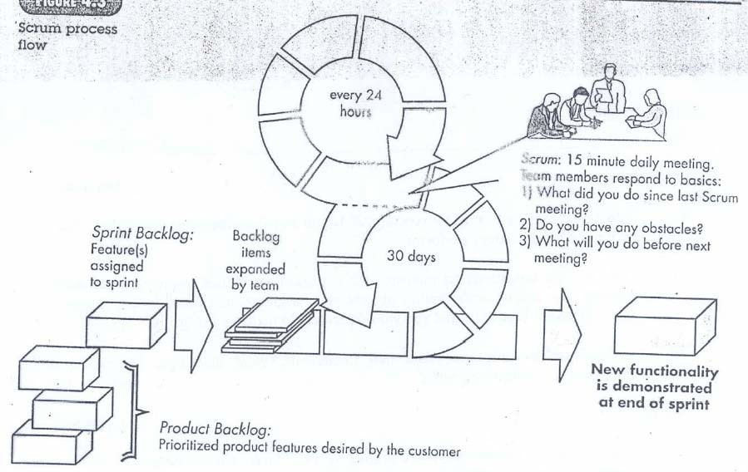
SCRUM

Slide 14
Scrum
Originally proposed by Schwaber and Beedle
Scrum—distinguishing features
  Development work is partitioned into “packets”
  Testing and documentation are on-going as the product is constructed
  Work occurs in “sprints” and is derived from a “backlog” of existing requirements
  Meetings are very short and sometimes conducted without chairs
  “demos” are delivered to the customer with the time-box allocated

Slide 15
Kanban
Agile Kanban is Agile Software Development with Kanban approach. In Agile Kanban, the Kanban board is used to visualize the workflow. The Kanban board is normally put up on a wall in the project room. The status and progress of the story development tasks is tracked visually on the Kanban board with flowing Kanban cards.
Kanban Board
Kanban board is used to depict the flow of tasks across the value stream. The Kanban board −
  Provides easy access to everyone involved in the project.
  Facilitates communication as and when necessary.
  Progress of the tasks are visually displayed.
  Bottlenecks are visible as soon as they occur.

Slide 16
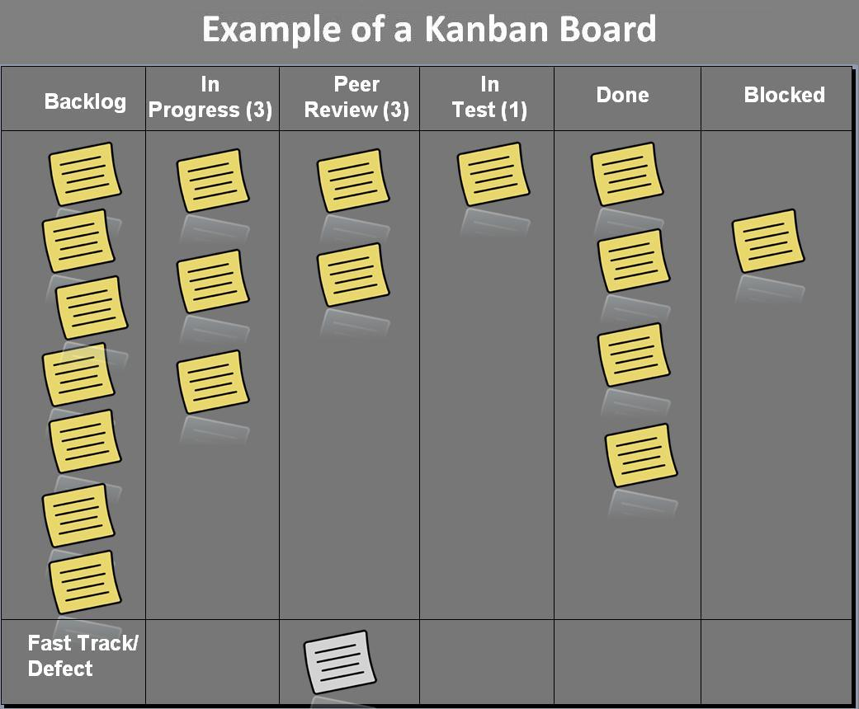
Kanban Board

Slide 17
Advantages of Kanban board
The major advantages of using a Kanban board are −
Empowerment of Team − This means −
  Team is allowed to take decisions as and when required.
  Team collaboratively resolves the bottlenecks.
  Team has access to the relevant information.
  Team continually communicates with customer.
Continuous Delivery − This means −
  Focus on work completion.
  Limited requirements at any point of time.
  Focus on delivering value to the customer.
  Emphasis on whole project.
The tasks and stories are represented by Kanban cards. The current status of each task is known by displaying the cards in separate columns on the board. The columns are labeled as To Do, Doing, and Done. Each task moves from To Do to Doing and then to Done.
Kanban Board is updated on a daily basis as the team progresses through the development.

Slide 18
Aspect-oriented Software Development
Certain ‘concerns’ – customer required properties – span the entire software architecture
Some concerns are high-level properties of a system (e.g. security)
Other concerns affect functions (e.g. application of business rules)
Others are systematic (e.g. memory management)
When concerns cut across multiple system functions and features, they are called cross-cutting concerns
AOSD provides a process and methodological approach for defining, specifying, designing, and constructing aspects like security, fault tolerance, adherence to business rules, DB mirroring, memory management, concurrency

Slide 19
Home reading Assignment
As a developer, which agile development model is best between scrum and Kanban? Explain the benefits of selected development model?

